Slide 1
VBA for Excel
Pôle Universitaire Léonard de Vinci
Session 2
Achraf Seddik
seddik.achraf.1@gmail.com

Slide 2
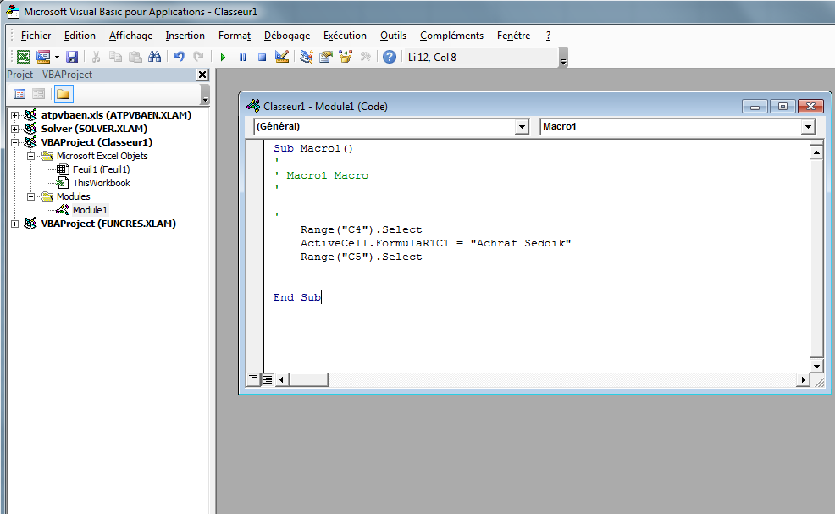
Recall
Begening and end of the macro :
Sub et End Sub delimits the beginning and the end of the macro, "Macro1" corresponds to the name (title) of this macro

Slide 3
Recall
Comment :
(preceded by an apostrophe)
is not taken into account in the execution of the code (very useful for instance to not to execute certain lines of code without deleting them)

Slide 4
Recall
Instructions :
Code that allows you to perform the needed tasks.
(Variables )

Slide 5
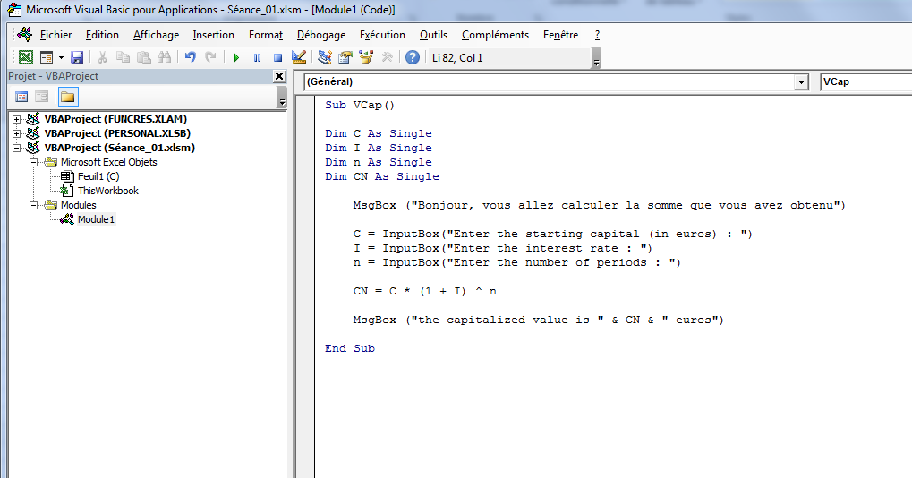
Recall
Variables declaration :
Code that allows you to perform the needed tasks.
(Variables )

Slide 6
Lesson 2 Conditional structures

Slide 7
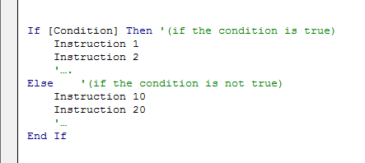
Conditional tests : "If" function
Conditions are very useful in programming, they will enable us to carry out actions according to some precise criteria.
The main conditional tests function in VBA is “If” function (same principle as “if” function in excel). Here is its syntax (Simple if):
→ If the condition (test) is true then the program executes instructions 1 and 2, otherwise (else) it executes instructions 10 and 20 (else).

Slide 8
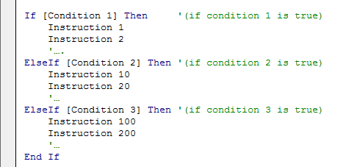
Conditional tests : Multiple If
It is possible to use multiple “if” functions :
→ If the condition1 is not true then the program checks condition 2, if it is not true, it checks condition 3, if it is true (then) it executes instructions 100 and 200.

Slide 9
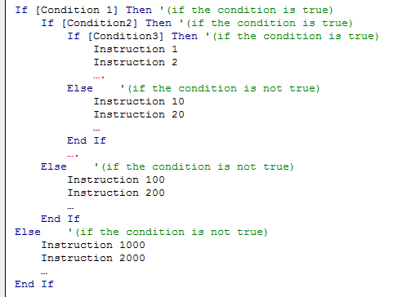
Conditional tests : Nested if functions
It is possible to imbricate (nest) “if” functions in each others :
Instructions 1 and 2 are executed when conditions 1, 2 and 3 are True
Instructions 10 and 20are executed when conditions 1, 2 are True but condition 3 is False
Instructions 100 and 200 are executed when conditions 1 is True but condition 2 is False

Slide 10
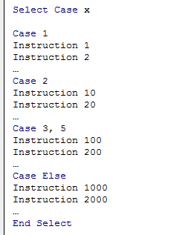
Conditional tests : Case test
Syntax :
If the condition in case 1 is true then the (then) instructions 1 and 2 are executed etc.

Slide 11
Applications Exercice Sheet N°2

Slide 12
Appendix.
1. VBA variables types
2. Operators
Arithmetic | ^ | - [negation] | * | / | + | & | Mod
Comparaison | = | <> [different] | < | > | <= | >= | Like | Is
Logical | Not | And | Or | Xor | Eqv | Imp

